Slide 1
Welcome to Section!
Week 2
Momina Jabeen

Slide 2
Agenda
1.
2.
3.
Check-In
Section Problem
Bonus Problems
How are we all doing?
Another fun, challenging, and engaging Karel problem
Expanding on Karel or diving into consoles!

Slide 3


Before We Start...
How are you all doing!? Hopefully your first week of CIP went well!
To start off section, let’s do a quick check-in question.
Choose one of the following to answer:
What’s one thing you have enjoyed or found fun about CiP so far?
What has been your favorite problem to work on so far?
What are you looking forward to using Python/CS for?
A CIP student baked these!

Slide 4
Are there any questions?

Slide 5

Section Problem
Another Karel problem! This time, we want to do something that is algorithmically interesting and challenging. This is intended to be harder than last week’s section problem!

Slide 6
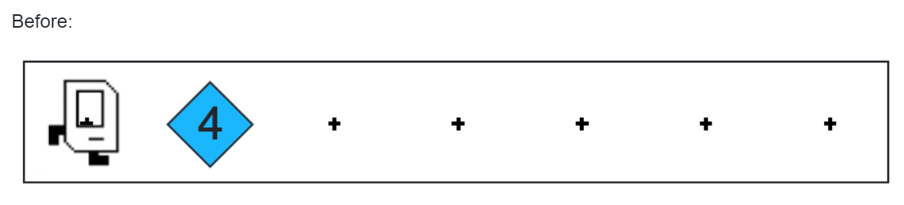
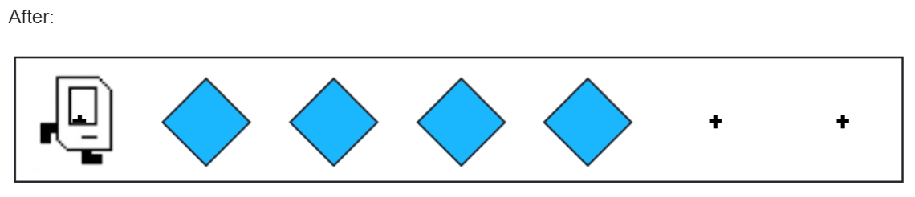
Section Problem: Spread Beepers
Sample Starting World
Sample Output World
We have some amount of beepers which are stacked in a single pile.
We want to take these beepers and spread them out across the row.
(Notice how there are still only four beepers in the world!!!)

Slide 7

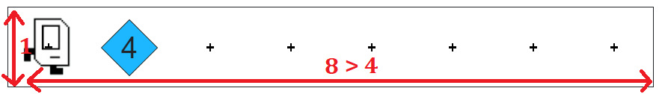
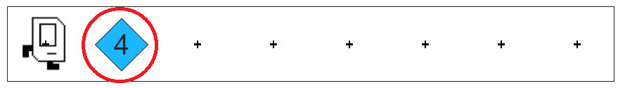
Key Problem Details
Beepers
World Attributes
Locations
The “catch” to this problem? Karel has infinite beepers in its bag
There is only one row in the world. The world is wide enough for all of the beepers
The pile of beepers is on the second column. (In front of where Karel starts.)

Slide 8
Are there any questions about the problem?

Slide 9
Let’s code this up!
Would you all prefer to do this in breakout rooms or as a whole group?

Slide 10
What were your thoughts on the problem?

Slide 11
(Bonus)
Algorithmic Practice or Console Practice?
Notes:
Have extra time? Have you or your students pick the bonus problem to do. You can decide this before or during the section. You can remove this slide if desired.

Slide 12
(Bonus)
Extending the Problem Even Further

Slide 13
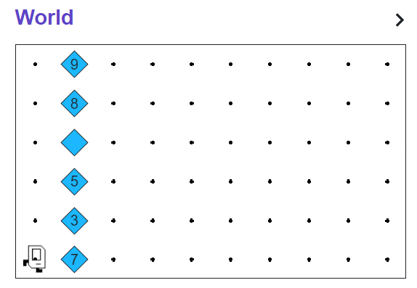
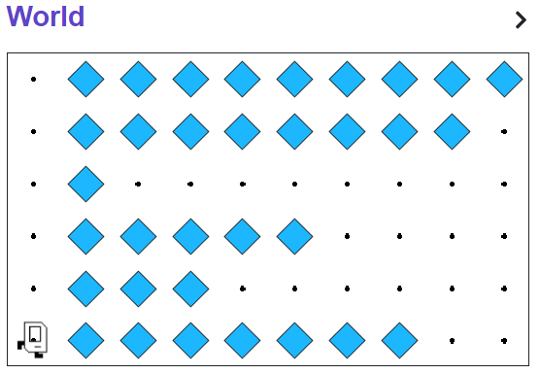
What if we add more rows?
Sample Starting World
Sample Output World
We have multiple rows with piles of beepers now!
We want to spread all of the rows!

Slide 14
(Bonus)
Console Programming

Slide 15
Let’s duplicate messages!
Sample Input
Sample Output
Enter any message you’d like:
↓
Enter any message you’d like: coding rocks!
(User input is in bold italics)
coding rocks!
coding rocks!
coding rocks!
coding rocks!
coding rocks!
coding rocks!
coding rocks!
coding rocks!
coding rocks!
coding rocks!

